Slide 1
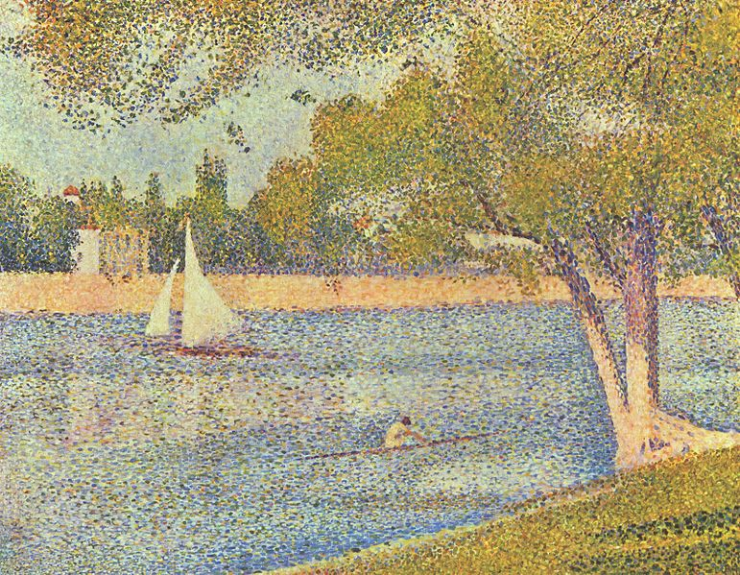
COMPSCI 111/111G Digital Images and Vector Graphics
Lecture 13 SS 2019
The Seine and La Grande Jatte – Springtime
George Seurat 1888
Notes:
The Seine and la Grande Jatte - Springtime 1888, Royal Museums of Fine Arts of Belgium. Georges Seurat – public domain image
http://en.wikipedia.org/wiki/Georges_Seurat

Slide 2
Learning Outcomes
Students should be able to:
Describe the differences between bitmap graphics and vector graphics
Calculate the size in bytes of a bitmap image
Compare and contrast different compression methods (jpeg, gif and png)

Slide 3
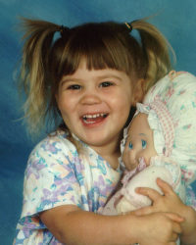
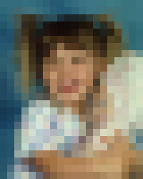
Bitmap Graphics
Storing pictures digitally
Sample the image (divide into dots)
Image resolution (number of dots)
200 x 250
40 x 50
20 x 25
http://en.wikipedia.org/wiki/Raster_graphics

Slide 4
Black and White pictures
Digital Pictures consist of small dots
Each dot is called a picture element (pixel)
Storing information
Black and White are only two states
Use bits to represent pixels (0 = OFF, 1 = ON)
One to one mapping, so known as Bitmap
0
0
0
0
0
1
1
0
0000011001100000
0
1
1
0
0
0
0
0
http://en.wikipedia.org/wiki/Pixel

Slide 5
Displaying images
Images are displayed on an output device
Screen / Printer
Physical devices have limitations
Printer
Screen
Very small dots
Large dots

Slide 6
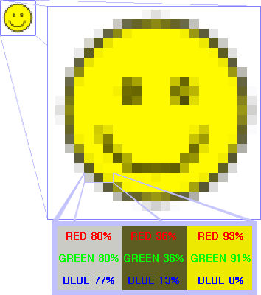
Resizing bitmap images

Slide 7
Resizing images
Image information with given resolution
8 x 6 pixels
Sampled at higher resolution
16 x 12
Sampled at lower resolution
4 x 3

Slide 8
Printing Bitmaps
Printer and Screen have different sized dots
Scale (resample) the bitmap to ensure it looks good on both
Printer resolution
600 or 1200 dpi
Printer
On disk
Screen resolution
72 dpi
On screen

Slide 9
Exercises
Imagine you have taken a picture with a 4 megapixel digital camera. For ease of calculation, assume that the picture is square, not rectangular.
Assume that you are printing this picture out on a printer that has approximately 4000 dots per inch. How many inches across would the picture be when it was printed?
If you viewed this image on a screen that had 1000 dots across, what portion of the image would be visible?
4 million pixels

Slide 10
Colour Bitmaps
Colours
Use more than 1 bit per pixel
Map the binary number to a colour
Bits | Colour
0000 | Black
0001 | Red
0010 | Green
0011 | Blue
0100 | Yellow
… | …
1100
0010
1111
1111
1010
0101
0010
1111
1000
0111
0000
1101
0110
1111
1110
1010
Each pixel uses 4 bits
Colour table used for display

Slide 11
How much memory is required?
One binary number used for each pixel
1 bit 2 colours
2 bits 4 colours
4 bits 16 colour
8 bits 256 colours
16 bits 65536 colours
24 bits 16,777,216 colours
How many bits are required for a 16 colour image 100 pixels wide x 8 pixels high?
100x8x4 = 3200 bits = 400 bytes
An image using 24 bit colour, 1000 wide x 1000 high (1 Megapixel)?
3 MB

Slide 12
Exercises
How many colours can be represented by 3 bits?
How many bits are required to represent 128 different colours?
How much memory would be required to store a black and white image that is 10 pixels high and 5 pixels wide? Show your working.

Slide 13
Exercises
How much memory (in bytes) would be required to store an image that has 256 different colours and is 3 pixels high and 5 pixels wide? Show your working.

Slide 14
Displays
Screens use a combination of Red, Green and Blue lights
RGB colour
Use one byte (8 bits) for each colour
256 different levels of red brightness
256 different levels of green brightness
256 different levels of blue brightness
A single pixel
at distance
A single pixel
close up

Slide 15
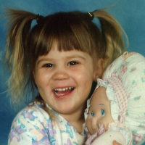
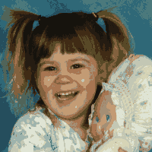
Compressing Images
Simply reducing number of colours
Image is 200 pixels wide, 200 pixels high
= 40,000 pixels
31,942 colours
75 KB
256 colours
40 KB
16 colours
20 KB

Slide 16
Compression Algorithms
Graphics Interchange Format (GIF)
Lossless method
256 colours
Good for graphics, poor for photos
Uses an algorithm that was patented
Image Size: 200x100
Original (256 colours): 20KB
GIF (256 colours): 3KB
Image Size: 200x200
Original (256 colours): 40KB
GIF (256 colours): 32KB
http://en.wikipedia.org/wiki/Gif

Slide 17
Compression Algorithms
Portable Network Graphics (PNG)
Replacement to GIF
Lossless method
16 million colours (24 bit)
Good for graphics, poor for photos
Image Size: 200x100
Original (256 colours): 20KB
PNG (16M colours): 4KB
Image Size: 200x200
Original (16M colours): 120KB
PNG (16M colours): 68KB
http://en.wikipedia.org/wiki/Png

Slide 18
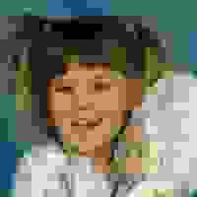
Compression Algorithms - JPEG
Joint Photographic Experts Group (JPEG)
Lossy method
16 Million colours (24 bit)
Averages nearby colours
Different degrees of compression
Good for photos, poor for graphics
Image Size: 200x100
Original: 60KB
JPEG (50%): 5KB
Image Size: 200x200
Original: 120KB
JPEG (50%): 6KB
Image Size: 200x200
Original: 120KB
JPEG (99%): 2KB
http://en.wikipedia.org/wiki/jpeg

Slide 19
Vector Graphics
Object-oriented graphics
Objects created independently
Defined by mathematical formulae
Advantages
Very small memory requirements
Memory independent of the image size
Scale to any size without loss of quality
Object Type: Square
Height: 100
Width: 100
Position_X: 354
Position_Y: 289
Fill Colour: Light Blue
http://en.wikipedia.org/wiki/Vector_graphics

Slide 20
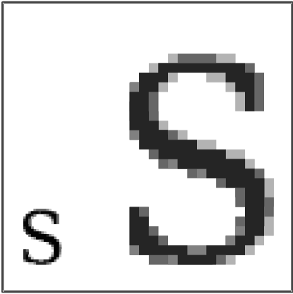
Bitmap and Vector Graphics
Bitmap
.gif, .jpg, .png
Vector Graphics
.svg

Slide 21
Scalable Vector Graphics
Format for representing vector graphics images
Open standard created by W3C
New, gaining popularity
XML, text file similar to HTML
<?xml version="1.0" encoding="utf-8" standalone="yes"?>
<!DOCTYPE svg PUBLIC "-//W3C//DTD SVG 1.1//EN" "http://www.w3.org/Graphics/SVG/1.1/DTD/svg11.dtd">
<svg xmlns="http://www.w3.org/2000/svg" xmlns:xlink="http://www.w3.org/1999/xlink" version="1.1" width="520" height="520"> <style type="text/css"> <![CDATA[ text{font-size:362px;font-weight:bold;font-family:"Times New Roman", serif} #P0 {fill:#d4a000;stroke:#000;stroke-width:9} #P1 {fill:url(#tl)} #P2 {fill:url(#bl)} #P3 {fill:url(#br)} #P4 {fill:url(#tr)} ]]> </style> <defs> <linearGradient id="dk"> <stop/> <stop style="stop-opacity:0" offset="1"/> </linearGradient> <linearGradient id="lt"> <stop style="stop-color:#ffe681"/> <stop style="stop-color:#ffe681;stop-opacity:0" offset="1"/> </linearGradient> <linearGradient x1="136.4" y1="136.4" x2="167.5" y2="167.5" id="tl" xlink:href="#lt" gradientUnits="userSpaceOnUse"/> <linearGradient x1="136.4" y1="383.6" x2="167.5" y2="352.5" id="bl" xlink:href="#lt" gradientUnits="userSpaceOnUse"/> <linearGradient x1="383.6" y1="383.6" x2="352.5" y2="352.5" id="br" xlink:href="#dk" gradientUnits="userSpaceOnUse"/> <linearGradient x1="383.6" y1="136.4" x2="352.5" y2="167.5" id="tr" xlink:href="#dk" gradientUnits="userSpaceOnUse"/> </defs> <path id="P0" d="M260,6.3L 6.3,260L 260,513.7L 513.7,260L 260,6.3z"/> <text y="380" x="200">!</text> <path id="P1" d="M260,12.7L 260,75L 75,260L 12.7,260L 260,12.7z"/> <path id="P2" d="M260,507.3L 260,445L 75,260L 12.7,260L 260,507.3z"/> <path id="P3" d="M260,507.3L 260,445L 445,260L 507.3,260L 260,507.3z"/> <path id="P4" d="M260,12.7L 260,75L 445,260L 507.3,260L 260,12.7z"/>
</svg>
http://en.wikipedia.org/wiki/Svg

Slide 22
Summary
Bitmap Images
Pixel width x pixel height = resolution
Use numbers to encode colour of each pixel (more colours = more bits per pixel)
Look jagged when enlarged too much
Take a lot of memory but can be compressed (e.g. JPG)
Vector Images
Defined by mathematical formulae
Can be enlarged and still look nice
Small compared to bitmap images

